Slide 1
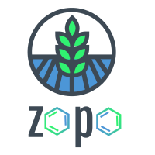
Z⬡P⬡
ECOSYSTEM
Connecting Earth and People through Technology

Slide 2
Z⬡P⬡’S VISION
We believe that blockchain technology allied to communities and organizations can revolutionize the plastic cleanup

Slide 3
PROBLEM
PLASTICS EVERYWHERE
WEAK MANAGEMENT
$ WASTE AND POLLUTION
Plastics pollution can be seen everywhere. In the oceans, rivers, streets, forests, mangroves...
Weak management structures are not able to cleanup the whole plastic waste
Both factors results in a global scale pollution and a big economic gap.

Slide 4

PROBLEM
6.3 billion metric tons
global plastic waste (1950-2015)
only ≅ 9%
other ≅ 91%
have been recycled
irregularly disposed
Environmental Collapse

Slide 5
PROBLEM IMPACTS
Ocean Pollution - 8mi tons per year enters the ocean
More than 600 endangered animal species
Clogged storm drain results in floods
Humans still don't realize it, but it directly affects our lives.

Slide 6
PROBLEM STATEMENT
LOCAL INSTITUTIONS AND GOVERNMENTS ARE NOT ABLE TO MANAGE THE PLASTICS RECYCLING SYSTEMS ALONE.
AND THERE IS NO MECHANISM TO BRING CITIZENS TOGETHER AND INCENTIVIZE THE LOCAL PLASTICS CLEANUP.

Slide 7
Z⬡P⬡ ECOSYSTEM
SOLUTION
Helps to create decentralized, customizable incentivized programs for local plastics cleanup

Slide 8
SOLUTION
Z⬡P⬡ allows ANY local stakeholder a simple way to incentivize, manage and successfully run a plastic clean up in their community. This includes companies, citizens, local governments, and institutions.
Organizations (Checkpoints)
Participants (Citizens)

Slide 9
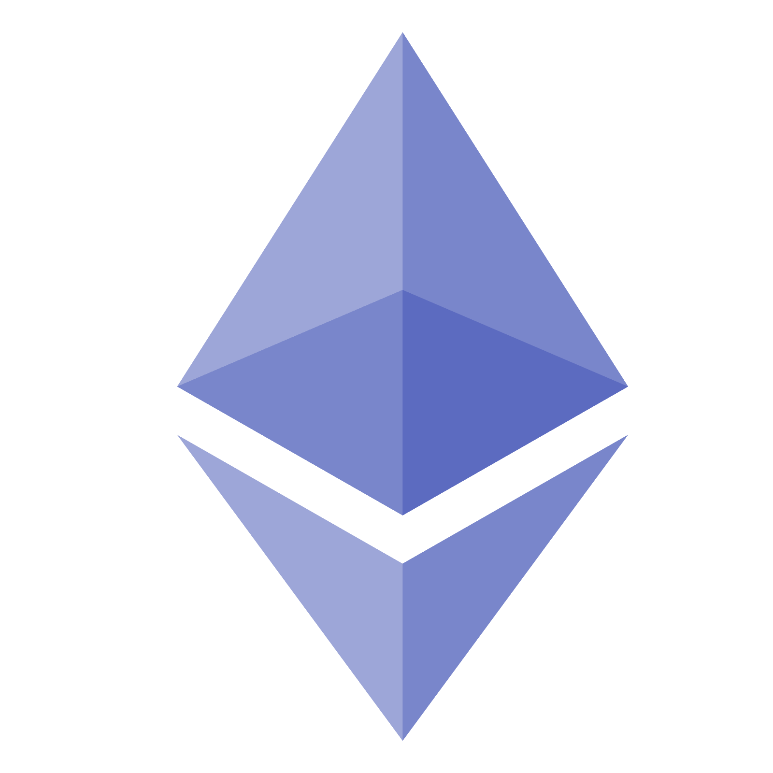
SOLUTION
DAPP
DISTRIBUTED POWER
FLEX BUSINESS MODEL
SUSTAINABLE
User friendly DApp running on robust Ethereum Smart Contracts
Empowered citizens and organizations are the fuel/engine of the Ecosystem
Roles, prizes, rewards, values, Tokens ​​can be customized to any target local
Focus on helping the environment by reducing plastic waste and increasing recycle

Slide 10

SOLUTION WORKFLOW
REGISTER
FIND CHECKPOINT
CHECK OUT BAG
COLLECT!
CHECK IN BAG
Easy blockchain register for Citizens and Checkpoints
Checkpoints can be easily found by Citizens through the map
Pick up a ZOPO Bag scanning QR Code and start the work
Collect the plastic waste and fill the ZOPO Bag
Go back to the Checkpoint, verify the full Bag and receive the prizes!

Slide 11
SOLUTION EPICS
FUTURE ECOSYSTEM EPICS
REPUTATION
ANALYTICS
TRACKING
All role behaviors will be managed to have a reputation mechanism. Entities may use this information for awards, honors, and other.
All Ecosystem transactions will feed a robust analytics module. Charts, Dashboards and more can be created - Infos like how many Citizens, bags, time of process per location.
With the mechanism of relationship between bags, Citizens, Checkpoints, Endpoints, we can track the origin of the plastic waste until the recycling destination.

Slide 12
TARGET MARKET
Private Sector
Plastic Sectors
Engaged Citizens
Public Sector
Stores, Trail Associations, Conscious Entrepreneurs, Sustainable Companies - B2B, B2B2P
Inputs for Plastic Recycling Industries and other, through the full Bags - B2B
Engaged people, projects and communities that want to be part of the Ecosystem - P2P
Support for local Government collection system, Education, Logistics, Environmental Services - B2G

Slide 13
OPPORTUNITY
ECONOMIC WASTE
4x MORE PLASTIC
HIGH COST PROCESS
$2.5 trillion Is the annual impact of the oceans plastic pollution in the global economy. In Brazil, non-treatment of plastic waste impacts around R$5.8 billion.
Plastic waste is expected to quadruple from 2010 to 2050 and global recycling capacity will only cover 1/3 of the waste.
The plastics recycle supply chain is complex and expensive, so it needs more solution possibilities.

Slide 14
BUSINESS MODEL
PROFITS
COSTS
Transaction Fees (ex. new Checkpoint)
% of Bags Production
Sale of Full Bags (Input)
Token Valuation
% on Ecosystem Sponsors (Stake)
Developers
Marketing and Partnership
Initial Gas fees
Support Team (in loco)
Initial Bags Production

Slide 15
COMPETITIVE ANALYSIS
sustainable + social impact
blockchain & incentives
bureaucracy free
all kinds of location
local validations
flexible business model
Bounty for Basura
Plastic Bank
ZOPO Ecosystem

Slide 16
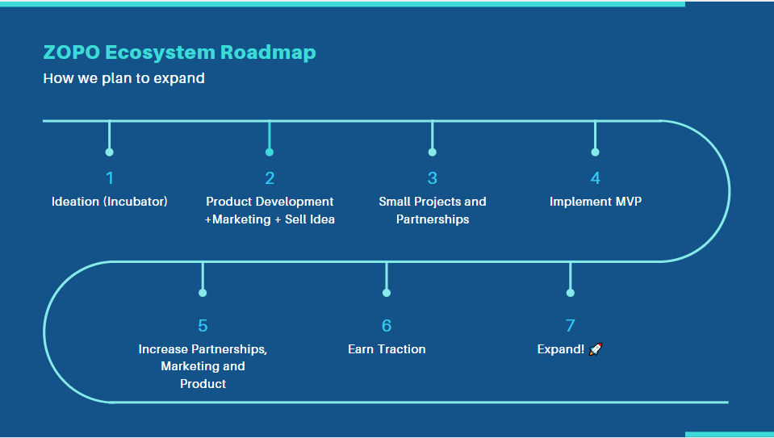
MVP PLAN

Slide 17
SUCCESS CRITERIA
KPI’s
MVP
Next 1 year
52k+
50%
500+
100+
10.4k
10+
100
10
2
BRAZIL LOCAL PROJECTS
CITIZENS
CHECKPOINTS and PARTNERS
COLLECTED BAGS
GLOBAL PROJECTS
CITIZENS
CHECKPOINTS and PARTNERS
COLLECTED BAGS

Slide 18
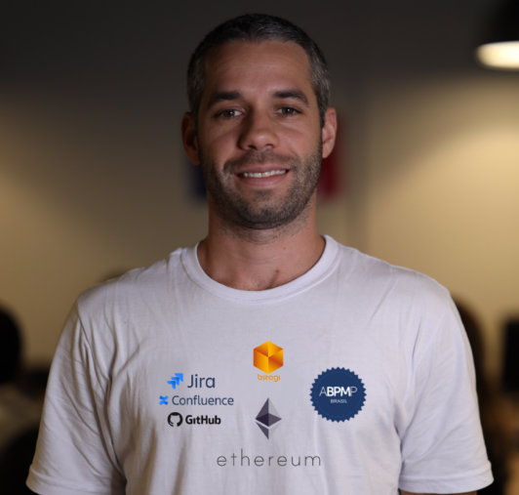
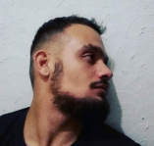
THIS IS
OUR
TEAM
RENAN MEIRELLES
PAULO SOUSA
Business Analysis
Full Stack Developer

Slide 19
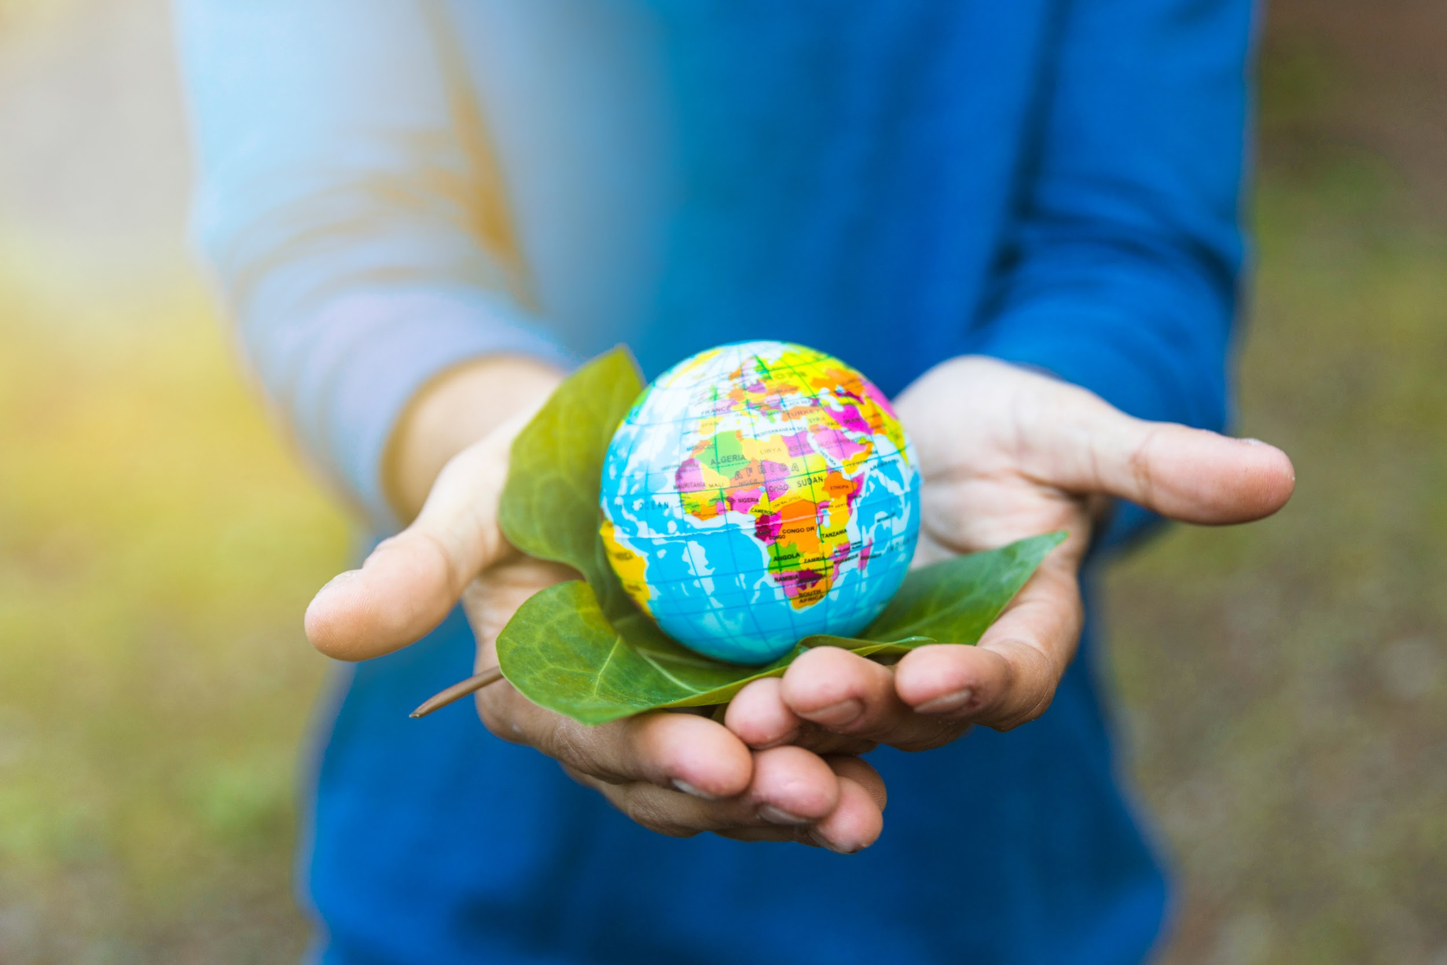
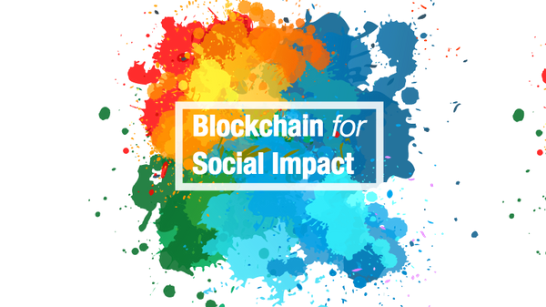
Thanks!
Do you have any questions?
meirelles.biz@gmail.com +55 (11) 99987-4902
Source Links:
NatGeo
PlasticOceans
TheBalances
PlasticMakers
OurWorldinData
AbiPlast
ImpactHub
ZOPO Links:
GitHub
GreenPaper
Landing Page

Slide 20
PROBLEM
TOP 4 PLASTIC WASTE PRODUCERS
USA
CHINA
BRAZIL
GERMANY
REMOVED
37.8mi ton of plastic waste per year. 9% recycled.
59.08mi ton of plastic waste per year. 22% recycled.
11.3mi ton of plastic waste per year. Only 1% recycled!!!
14.48mi ton of plastic waste per year. 5% recycled.

Slide 21
PROBLEM SOURCES
IRREGULAR DISPOSAL
LACK OF INVESTMENT
LACK OF EDUCATION
POPULATION DENSITY
Big industries and producers discard plastic in an irregular way
Poorest or or mismanaged countries are unable to pay the high operation cost
Populations with lack of environmental awareness help with irregular disposal
Overcrowded sites are not able to efficiently collect and dispose plastic waste

